Slide 1


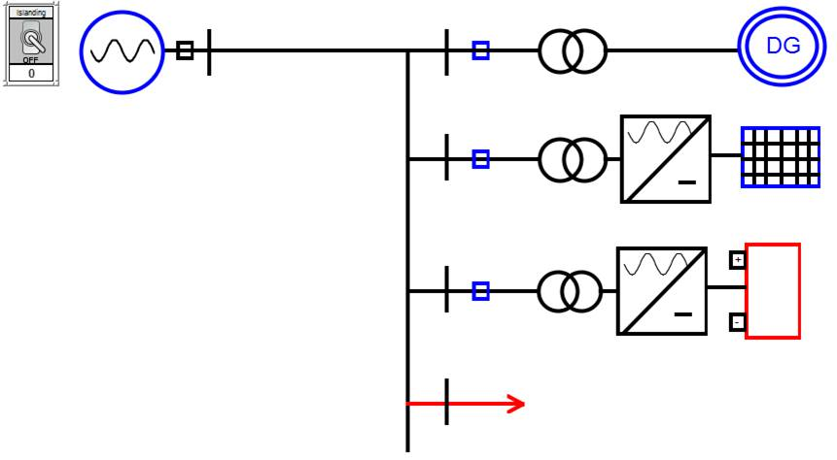
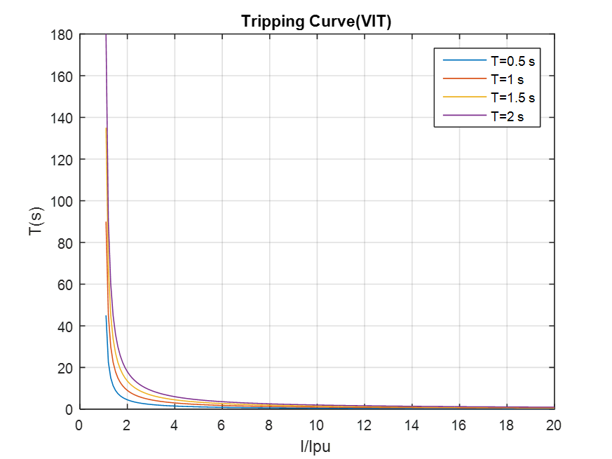
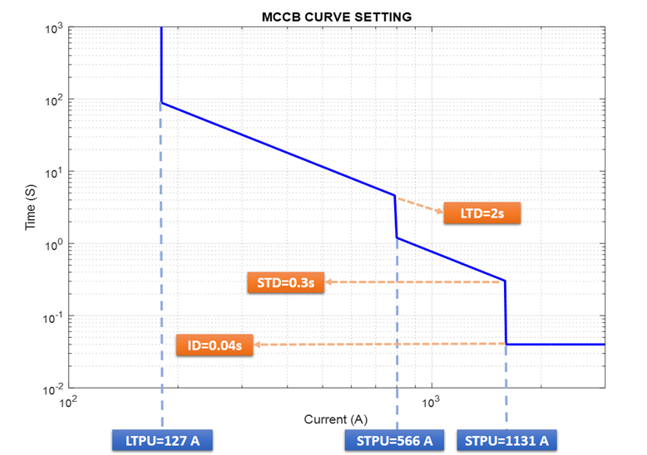
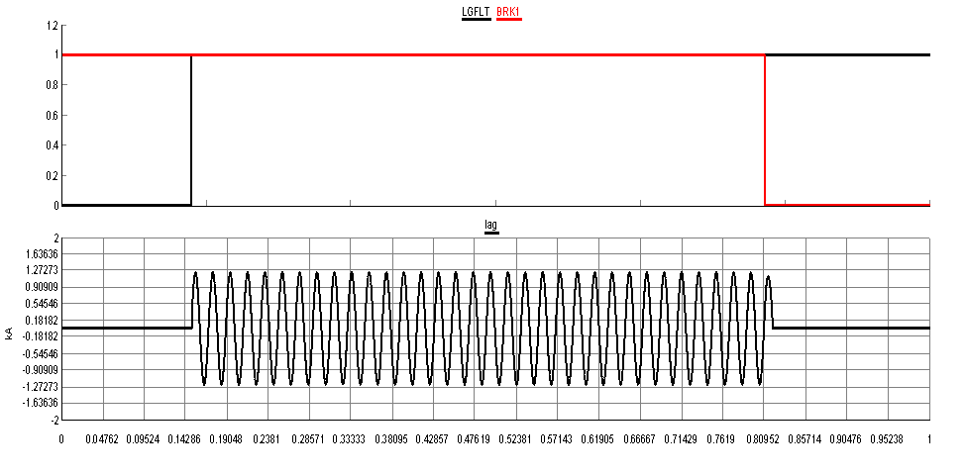
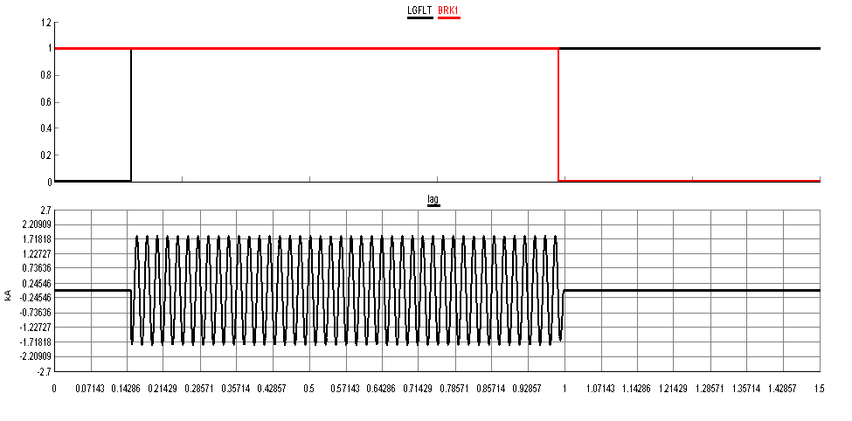
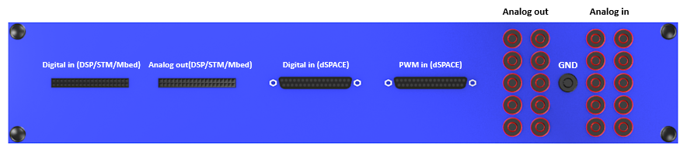
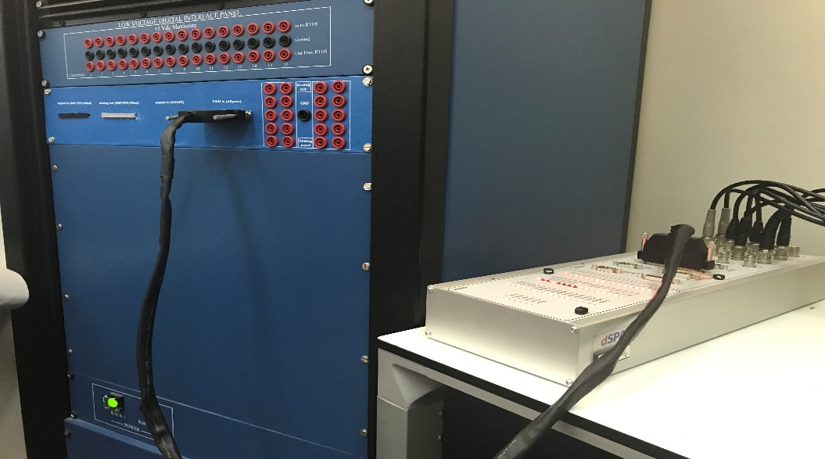
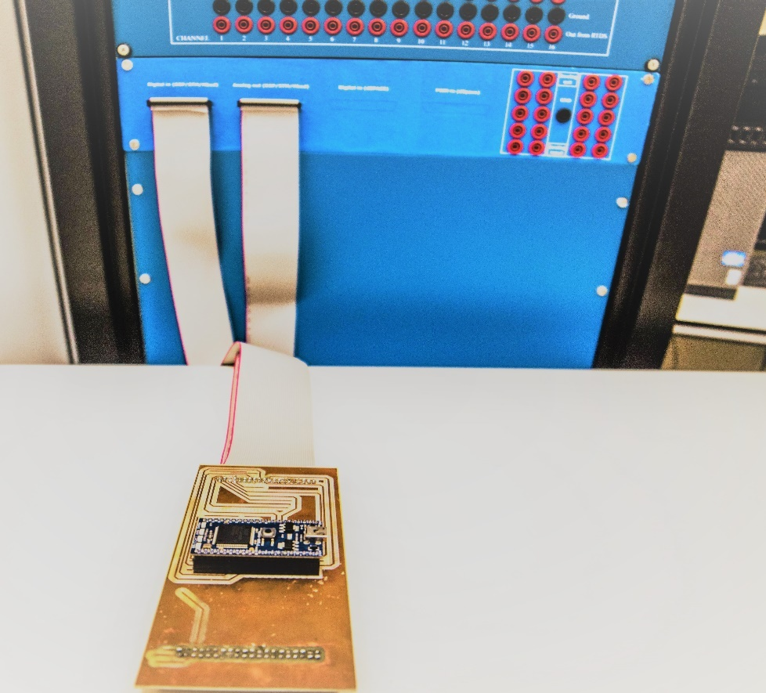
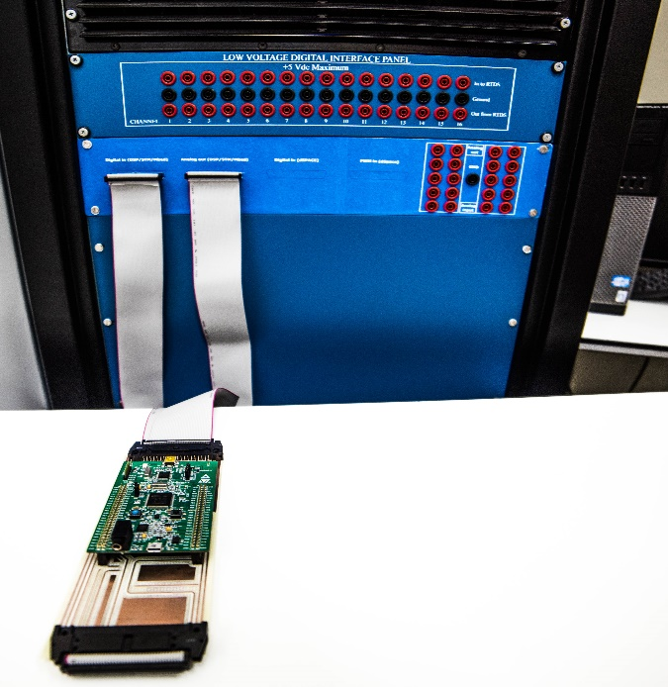


Design of a Test-Bed for Real Time Testing and Validation of Smart Grid Devices and Algorithms at QU
Design of a Test-Bed for Real Time Testing and Validation of Smart Grid Devices and Algorithms at QU
Khalid Bakhit, Muslim Ali, Mohamed Mohamed, Mohamed El Amin | Prof. Adel Gastli | Qatar University l
ABSTRACT
1. Microgrid EMS
3. Digital Relay
This project aims to the development of a smart grid testbed using Real Time Digital Simulator (RTDS) and some of controllers that are used by EE researchers. This testbed will be the core of the Smart Grid Demonstration and Research Investigation Lab (SGDRIL) in Qatar University. It will be used by researchers, post-graduate students and instructors in QU for testing and validating.
An EMS for the microgrid was modelled in the RTDS (figure 5). as the first advanced application. The microgrid that is considered consists of renewable energy sources, battery storage system, diesel generators (DG), controllable loads. This combination will offer a variety of scenarios that could be used experimenting, testing and validating EMS for microgrids.
Table 1 shows the scenarios checked through the EMS.
Smart grid has introduced a large number of distributed energy sources such as PV panels which allows bidirectional power flow. As a result, bidirectional short circuits may accurse, islanding and many other issues regarding power quality. Under these circumstances, remotely controlled protection system that is usually derived using a distribution management system or SCADA, is used. One of the main protection devises that use to maintain safe power system is protective relay. There are many types of relays that are normally used such as overcurrent (directional and unidirectional), distance and deferential relays. Digital relays nowadays are used because they offer economic and feasible alternative moreover they are used in research areas.
Results:
Finally, the results were acceptable compared to the ability of the MBED. However, there are two main sources that produce the error. The first one due to the MBD ADC which produces a lot of spicks that harm the readings. Secondly, the other cause of error is the delay caused by the calculation of the RMS since the full period have to be measured for more accurate value. To improve the performance of the relay a more powerful microcontroller should use to reduce the error that induced by the MBED.
The microgrid operate in two modes of operation, interconnected or islanded mode. Through the interconnected mode, when the grid is connected, the DG is disconnected, the battery is charging. On the other hand, through the islanded mode, when the grid is disconnected, one of the two following control methods below is used to maintain the power balance in the microgrid.
INTRODUCTION
One of the hottest topics that is being discussed and researched now in electrical engineering is what is known as the smart grid. Smart grid is an electric or power grid that allow many new control and automation applications to be done in the generation, transmission, and distribution of electric power that will yield to lower cost, better efficiency, and high reliability of the power system. That can be achieved using smart technologies such as wireless communication, power electronics etc. Moreover, it can also open the door to new ideas such as HVDC, electric vehicles home charging and bidirectional power flow. The idea of smart grid is necessary for implementing smart life style by all its aspects.
The project mainly consist of two applications which are:
Microgrid Energy Management System (EMS): which was done by interfacing the RTDS with the dSPACE DS1104 controller.
Digital Relay: Achieved by intergacing the RTDS with the MBED.
Figure 5: Microgrid simulation in RTDS
EMS by DG control
EMS by battery control
The DG only operate during islanded mode. That is, if both the battery and the PV panel are not enough to satisfy the load demand. The diesel generator power is calculated as follows:
The amount of power supplied by the battery is:
$$P_{bat}=P_{L} – P_{pv}$$
However, the battery is limited to max supply of 4 MW. If Pbat > 4 , the diesel generator is switched on where its supply is internally controlled by the RTDS.
Table 2 shows the scenarios checked through the EMS.
$$P_{dg}=P_{L} – (P_{pv}+|P_{bat}|)$$
Table 1: The microgrid scenarios during DG control
Table 2: The microgrid scenarios using Battery control
Very inverse tripping curve type
MCCB Curve showing tripping setting values
 | Utility Power (MW) | Load (MW) | Battery |  | Diesel Gen. (MW) | Solar Power (MW)
 |  |  | SOC (%) | Power (MWh)
#1 | -13.26 | +10 | 30% to 90% | +5 | ̶ | -1.74
#2 | -8.26 | +10 | More than 90% | ̶ | ̶ | -1.74
#3 | ̶ | +5 | 30% to 90% | -3 | -0.37 | -1.74
#4 | ̶ | +5 | 30% to 90% | -3.26 | ̶ | -1.74
#5 | ̶ | +5 | 30% to 90% | -1 | -2.74 | -1.26
#6 | ̶ | +5 | 30% to 90% | -2.5 | -2.5 | ̶
#7 | ̶ | +5 | Less than 30% | ̶ | -3.26 | -1.74
 | Utility Power (MW) | Load (MW) | Battery |  | Diesel Gen. (MW) | Solar Power (MW)
 |  |  | SOC (%) | Power (MWh)
#1 | -4.26 | +10 | 30% to 90% | +4 | ̶ | -1.74
#2 | -8.26 | +10 | More than 90% | ̶ | ̶ | -1.74
#3 | ̶ | +5 | 30% to 90% | -3.26 | ̶ | -1.74
#4 | ̶ | +5 | 30% to 90% | -4 | -0.5 | -0.5
#5 | ̶ | +5 | 30% to 90% | -4 | -1 | ̶
#6 | ̶ | +5 | Less than 30% | ̶ | -3.26 | -1.74
Component
Component
Scenario
Scenario
The following figures shows the voltage and frequency fluctuation in per unit at islanding using DG control.
The following figures shows the voltage and frequency fluctuation in per unit at islanding using battery control.
Overcurrent relay result (Ifault=1273 A)
MCCB result (Ifault=1273 A)
Hardware Connections
The front panel of the RTDS was designed and fixated as seen in figure 1 below:
Connections between RTDS & controllers was established as follows:
Figure 1: Front panel interfacing board between the controllers and the RTDS
Figure 6: Voltage and frequency changes at islanding (DG control)
Figure 7: Voltage and frequency changes at islanding (Battery control)
Conclusion & Future Work
Per the design constraints of this project. It was required to design a testbed for smart grid applications testing and validation using the RTDS. The design should include a hardware interface set for the ease of use. In addition to some simple applications for learning purposes and connections bench marking. Furthermore, advanced applications should be model to validate the testbed and afterward be used for research purposes. The first fully designed application in this project was a DC-DC buck converter using small-time step modelling. The design was simulated on Matlab/Simulink first for referencing then it was implemented using RSCAD. The next step after investigating the testbed capabilities and updating the RTDS with a neat hardware interface that makes it easier for controller’s connection and benchmarking. Several advanced applications where developed in the testbed. First, an EMS for microgrid. After modelling the microgrid with the help of RSCAD samples library and some published work. The microgrid consists of DERs such as solar panels, DG and BESS. These DERs are connected to the grid and some loads. The EMS algorithm was design in two different ways. The first method was to supply some of the loads using the solar panels and charge the BESS while the grid is connected and in islanding some of the loads will be shaded and the BESS will supply the leftover demand with the help of the PV panels. In case of any shortages in power, the DG will compensate that power shortage with commands from the centralised control with a specific amount of power generation (P_{ref}). In the second method, instead of having a fixed discharging rate from the BESS. The commands will be send to the BESS and the DG will compensate automatically to any power shortage. In results, the second methodology shows more potential in term of fast response and BESS SOC control.
Figure 2: Interface between RTDS & dSPACE
Figure 3: Interface between RTDS & MBED
Figure 4: Interface between RTDS & STM

